Slide 1
Palliative Care Futurist:
Matching Care to Our Patient's Needs
Diane E. Meier, MD
Director, Center to Advance Palliative Care
diane.meier@mssm.edu
www.capc.org
www.getpalliativecare.org
@dianeemeier
Notes:
Title slide uses CAPC Brand Blue + a Darker Blue
The Font is Arial throughout

Slide 2
No Disclosures

Slide 3
Objectives
Articulate the 2 primary differences between eligibility for palliative care and hospice
Operationalize the link between integration of palliative care and improved performance on key CMS hospital star and USNWR quality rankings
Identify the 6 predictors of a high value system-wide palliative care strategy

Slide 4
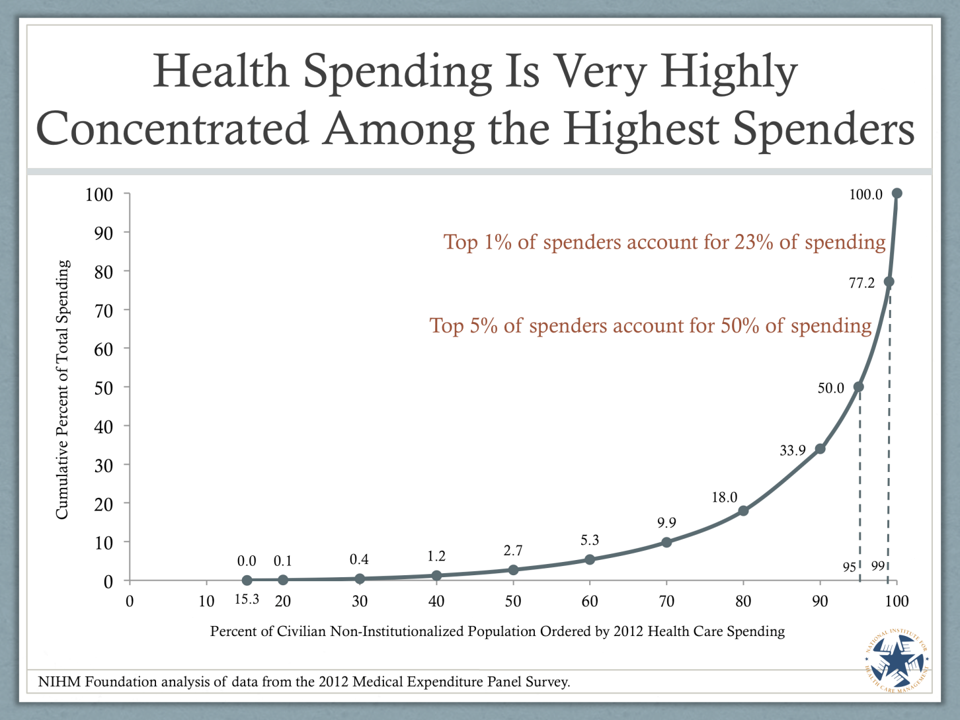
Concentration of Risk/$

Slide 5
Value= Quality/Cost
Because of the Concentration of Risk and Spending, and the Impact of Palliative Care on Quality and Cost, its Principles and Practices are Central to Improving Value

Slide 6
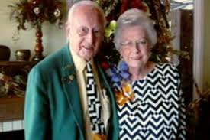
Mr. B
An 88 year old man with dementia admitted via the ED for management of back pain due
to prostate cancer, spinal stenosis and arthritis.
Pain is 8/10 on admission, for which he is taking 5 gm of acetaminophen/day.
Admitted 3 times in 2 months for pain (2x), falls, and altered mental status due to constipation.
His family (83 year old wife) is overwhelmed.

Slide 7
Mr. B:
Mr. B: “Don’t take me to the hospital! Please!”
Mrs. B: “He hates being in the hospital, but what could I do? The pain was terrible and I couldn’t reach the doctor. I couldn’t even move him myself, so I called the ambulance. It was the only thing I could do.”
Modified from and with thanks to Dave Casarett

Slide 8
Before and After
Usual Care
Palliative Care
4 calls to 911 in a 3 month period, leading to
4 ED visits and
3 hospitalizations, leading to
Hospital acquired infection
Functional decline
Family distress
Housecalls referral
Pain management
24/7 phone coverage
Support for caregiver
Meals on Wheels
Friendly visitor program
No 911 calls, ED visits, or hospitalizations in last 18 months

Slide 10
Who are the costliest 2.5%?
Functional Limitation
Frailty
Dementia
Exhausted overwhelmed family caregivers
Social + behavioral health challenges
+/- Serious illness(es)

Slide 11
What is Palliative Care?
Specialized medical care for people with serious illness and their families
Focused on improving quality of life. Addresses pain, symptoms, stress of serious illness.
Provided by an interdisciplinary team that works with patients, families, and other healthcare professionals to provide an added layer of support.
Appropriate at any age, for any diagnosis, at any stage in a serious illness, and provided together with disease treatments.

Slide 12
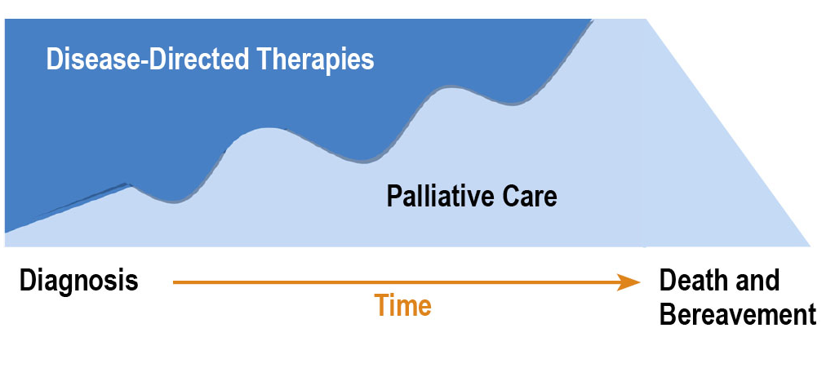
Conceptual Shift for Palliative Care
Medicare Hospice Benefit
Life Prolonging Care
Not this
Life Prolonging
But this
Hospice Care
Care
Palliative Care
Bereavement
Dx
Death
12

Slide 13
Synonyms
Palliative care
Advanced illness management
Advanced care
Supportive care
Serious illness care
THEY ARE ALL THE SAME THING

Slide 14
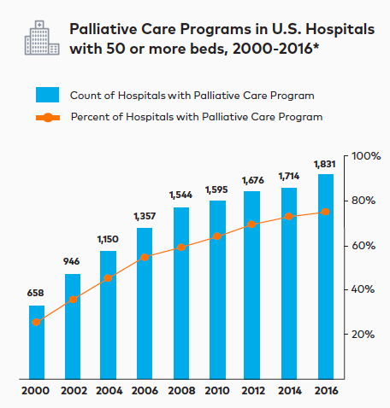
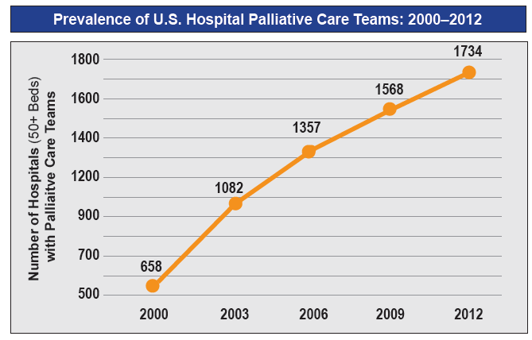
U.S. Hospital Palliative Care Growth
In 2016, >1,800 hospital programs (78% of US hospitals) were serving over 10MM patients each year.
Palliative care prevalence and # of patients served has more than tripled since 2000.
100% of the U.S. News 2015 – 2016 Honor Roll Hospitals and Children’s Hospitals Have a Palliative Care Team.

Slide 15
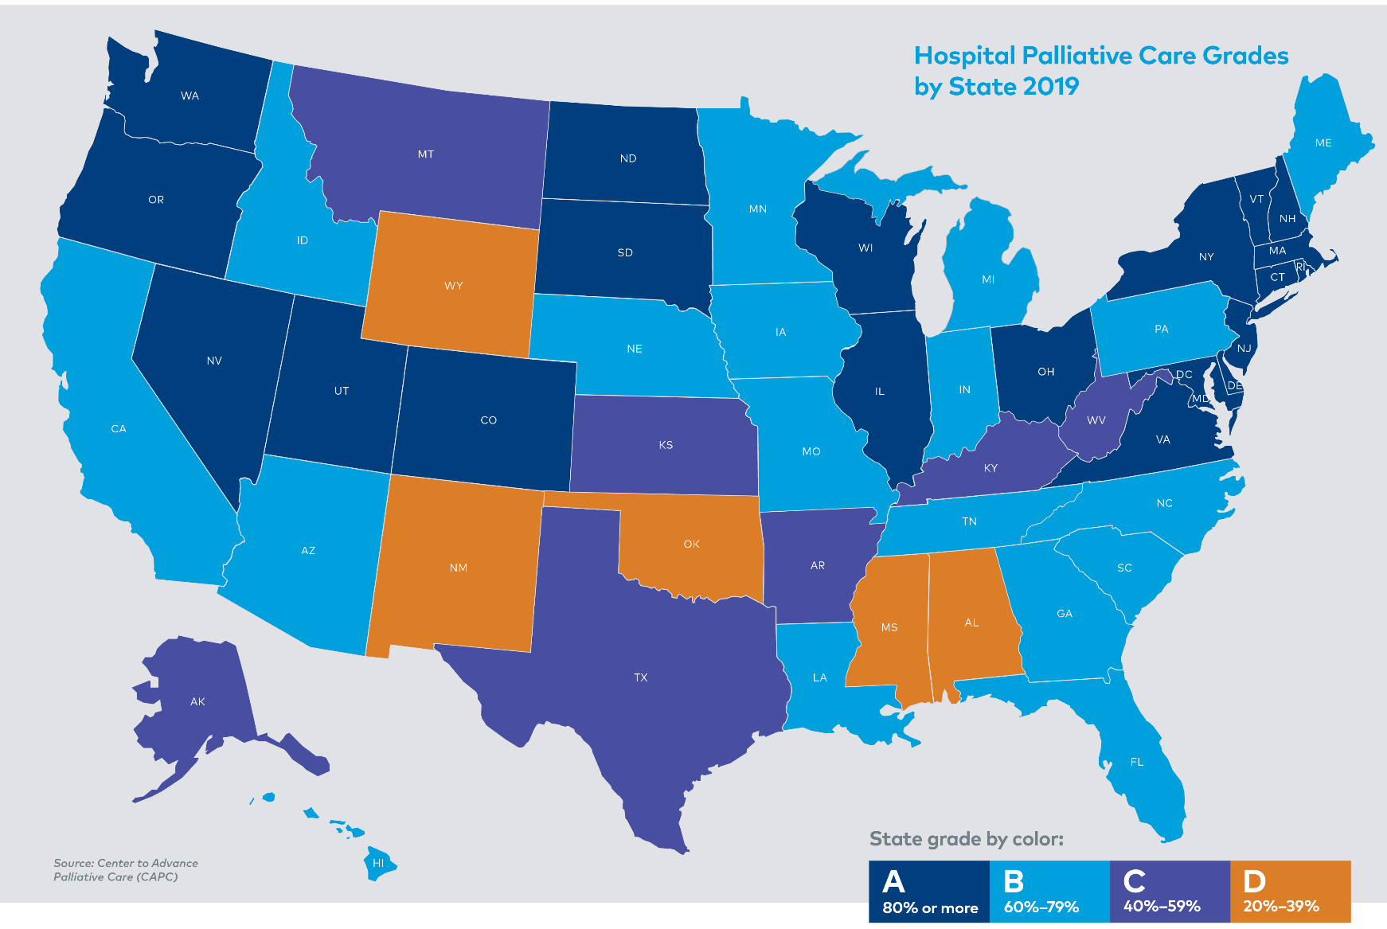
America’s Care of Serious Illness: A state-by-state report card on access to palliative care in our nation’s hospitals (2019)

Slide 16
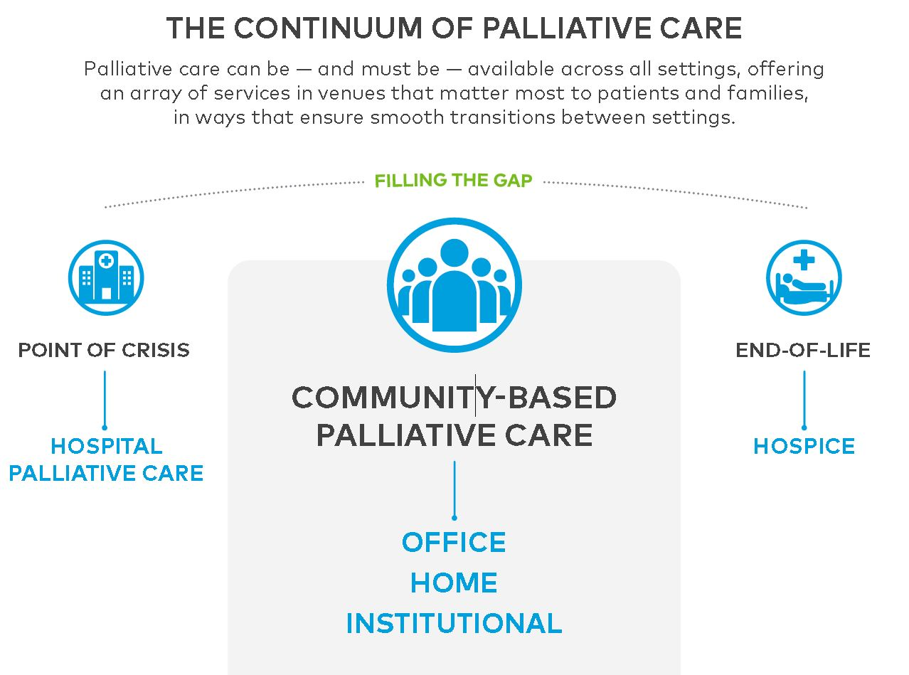

Slide 17
Mapping Community Palliative Care
Findings to Date
994 community programs participated, reporting services in 3,696 sites:
  2,398 in LTC facilities
  645 in office practices or clinics
  653 in-home, reaching 1,627 (52%) of U.S. counties

Slide 18
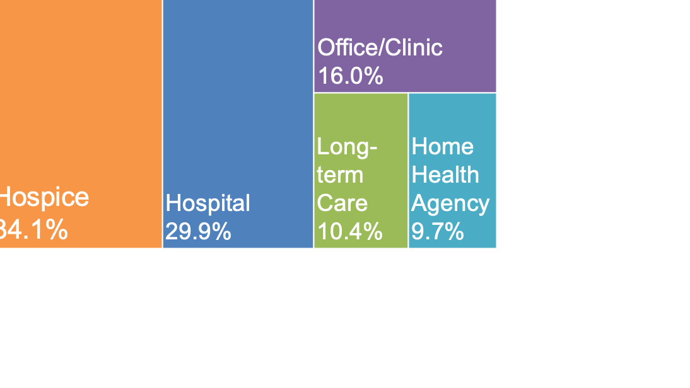
Hospice organizations administer >33% of participating community palliative care programs

Slide 19
Community Palliative Care Programs Administered by a Hospice
339 programs administered by a hospice organization identified 2,385 service sites through the Mapping Community Palliative Care survey (to date)

Slide 20
Palliative Care Improves Value
Quality improves
  Symptoms
  Quality of life
  Length of life
  Family satisfaction
  Family bereavement outcomes
  MD satisfaction
Costs reduced
  Hospital cost/day
  Use of hospital, ICU, ED
  30 day readmissions
  Hospitality mortality
  Labs, imaging, pharmaceuticals

Slide 21
Palliative Care in Office Setting
Randomized trial simultaneous standard cancer care with palliative care co-management from diagnosis versus control group receiving standard cancer care only:
  Improved quality of life
  Reduced major depression
  Reduced ‘aggressiveness’ (less chemo < 14d before death, more likely to get hospice, less likely to be hospitalized in last month)
  Improved survival (11.6 mos. vs 8.9 mos., p<0.02)
Temel et al. Early palliative care for patients with non-small-cell lung cancer NEJM2010;363:733-42.
Notes:
21

Slide 22
Palliative Care at Home Improves Quality, Markedly Reduces Cost
RCT of Service Use Among Heart Failure, Chronic Obstructive Pulmonary Disease, or Cancer Patients While Enrolled in a Home Palliative Care Intervention or Receiving Usual Home Care, 1999–2000
KP Study Brumley, R.D. et al. JAGS 2007
Notes:
December 7, 2010

Slide 23
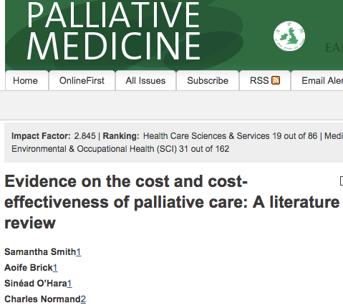
46 High Quality Studies 2002-11 Palliat Med 2014;28:130-50.

Slide 24
Why should Health Systems Care About Palliative Care?
Concentration of risk and spending in the subset of patients with serious illness
Evidence that palliative care improves value (improved quality and reduced cost) for this subset
Few strategies simultaneously improve quality and reduce spending

Slide 25
Impact of Palliative Care on Core Quality Metrics Clearly Demonstrated
Measures
Quality Reporting Entities
Readmissions
Hospital mortality
Communication
Pain communication
Likelihood to recommend
HCAHPS
CMS Hospital Stars
USNWR Best Hospitals
Watson Health 100 Top Hospitals
Leapfrog Hospital Safety Grades

Slide 26
Palliative Care
Screening on admission
Early engagement
Communi-cation
Symptoms managed
Family support
Reduced hospital mortality, and 30d readmission
Improved HCAHPS
✔CMS Hospital Stars
✔USNWR
✔Leapfrog
✔Watson Health 100 Top Hospitals
Safe timely discharge
24/7 access
Communication
Symptoms managed
Family support

Slide 27
How does it work?

Slide 28
Top 6 Characteristics of Effective Palliative Care
Adequately staffed and educated teams in the relevant settings
Screen, then target the highest risk people
Ask people what matters most to them
Support family and other caregivers
Expert pain/symptom management
24/7 access, all settings

Slide 29
Goal Setting
Ask the person and family, “What is most important to you?”

Slide 30
What is most important?
Survey of Senior Center and Assisted Living subjects, n=357, dementia excluded, no data on function.
Asked to rank order what’s most important:
1st Independence (76% rank it most important)
2nd Pain and symptom relief
3rd Staying alive.
Fried et al. Arch Int Med 2011;171:1854

Slide 31



Slide 32
“I don’t want Jenny to think I’m abandoning her.”
Response to my question asking an oncologist what he hoped to accomplish through intrathecal chemotherapy for a patient with brain metastases from lung cancer.
Meier DE. Health Affairs 2014;33:895-8

Slide 33


Slide 34
Oncologist Offers Intrathecal Chemo (aka most important lesson of my career so far)
Jenny asks what I think. I tell her I’ll call the oncologist.
I ask “I don’t have much experience with this procedure. What are you hoping we can accomplish with it?”
He says “It won’t help her.” Long pause.
I ask “Do you want me to encourage her to go ahead with it?”
He says, “I don’t want Jenny to think I am abandoning her.”

Slide 35
Conclusion
Problem?
Lack of Training
Solution?
Training

Slide 36


Slide 37
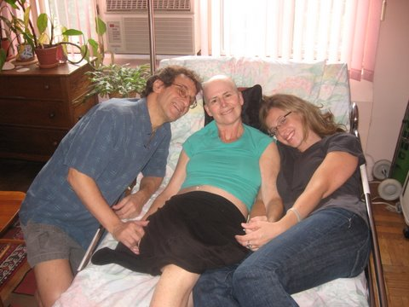
In Loving Memory

Slide 38
What we know about gaps in the U.S. health system
Missing or inadequate conversations about what matters most to patients and families
Uncontrolled symptoms leading to preventable ED visits and hospital stays
Exhausted family caregivers
Poorly coordinated care across clinical teams and through transitions, and…
More patients in need
Notes:
Blue Text for Headlines and Blue Arrows for Bullet Points
CAPC Brand blue = #00a0df

Slide 39
We have a lot to be proud of
Impact of palliative care in the COVID Era
Notes:
We can do this!

Slide 40

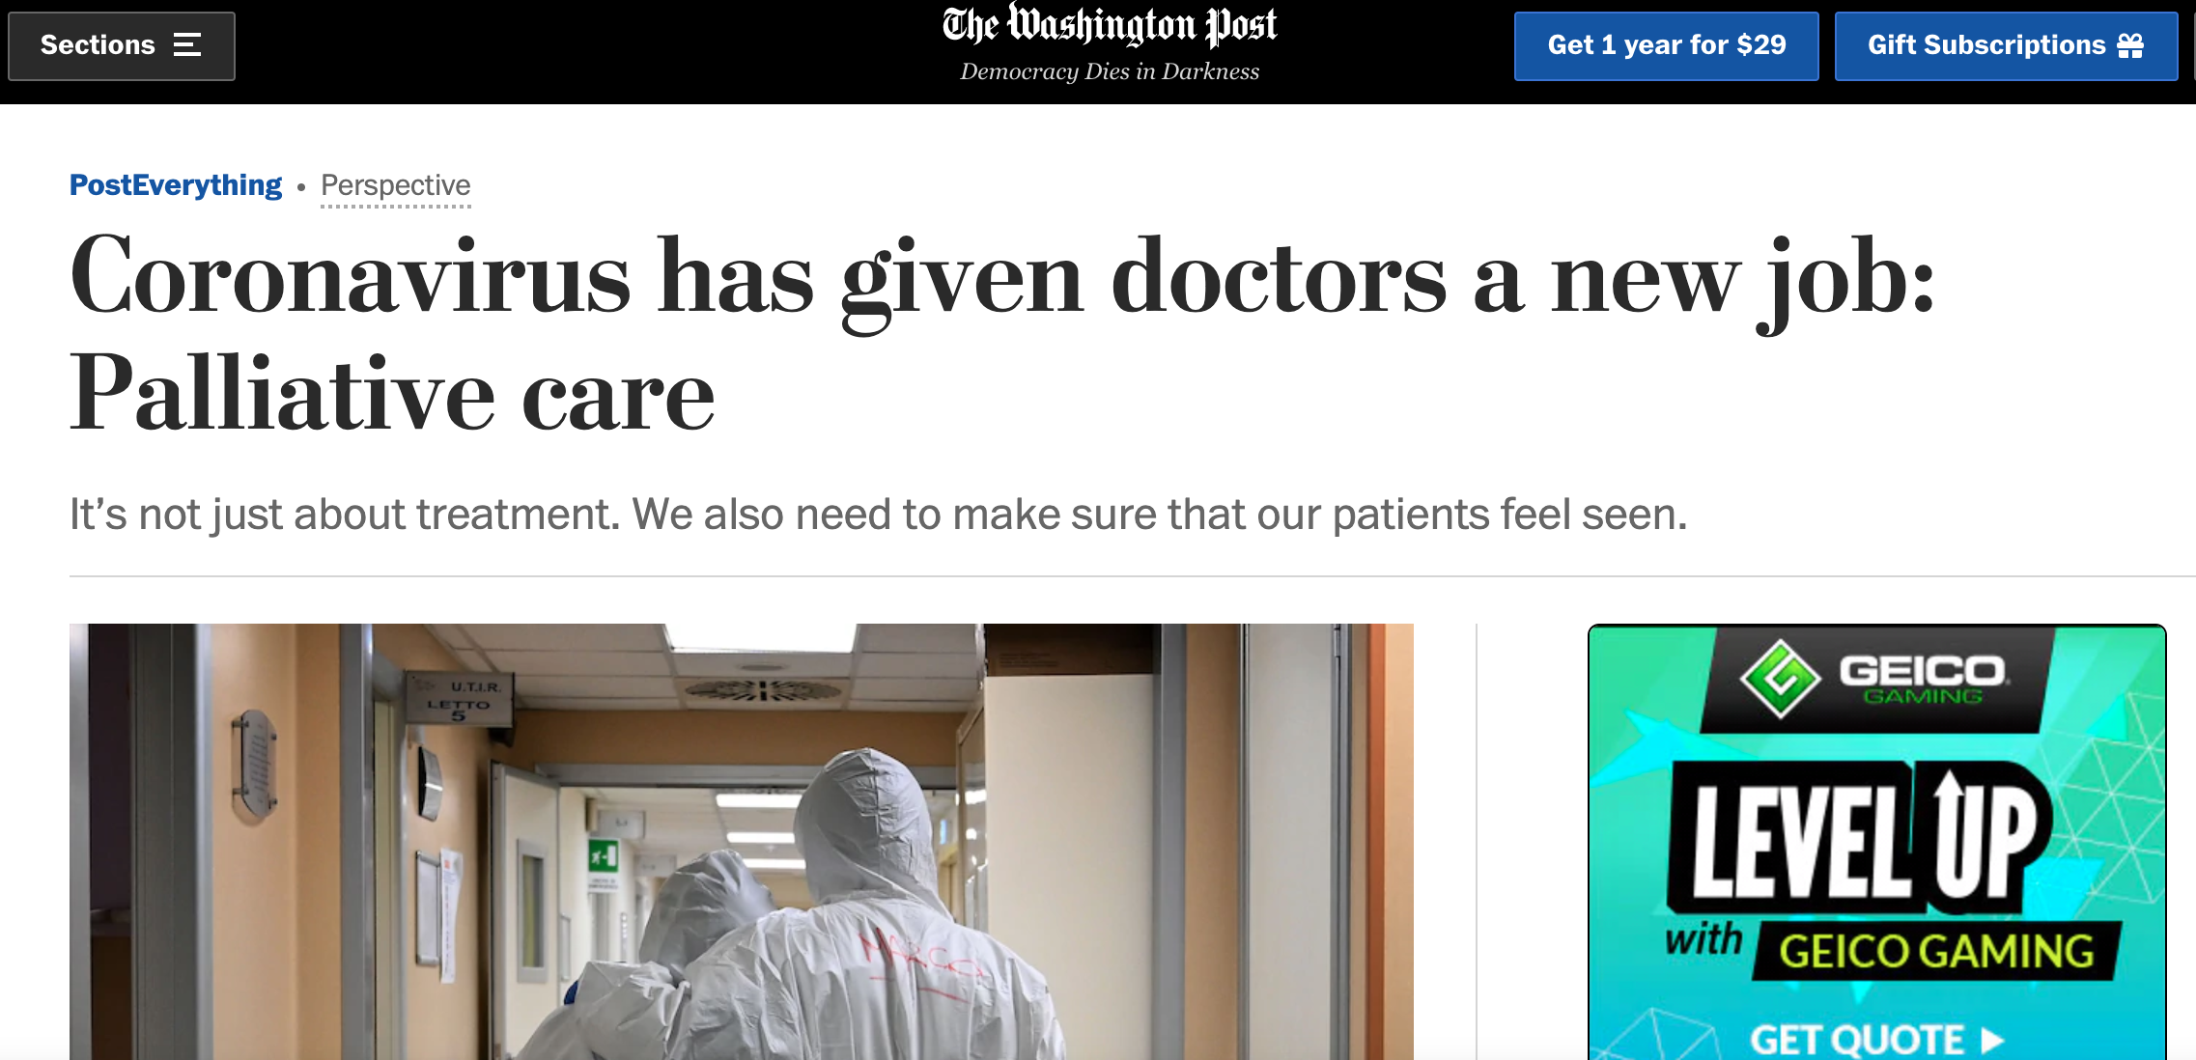
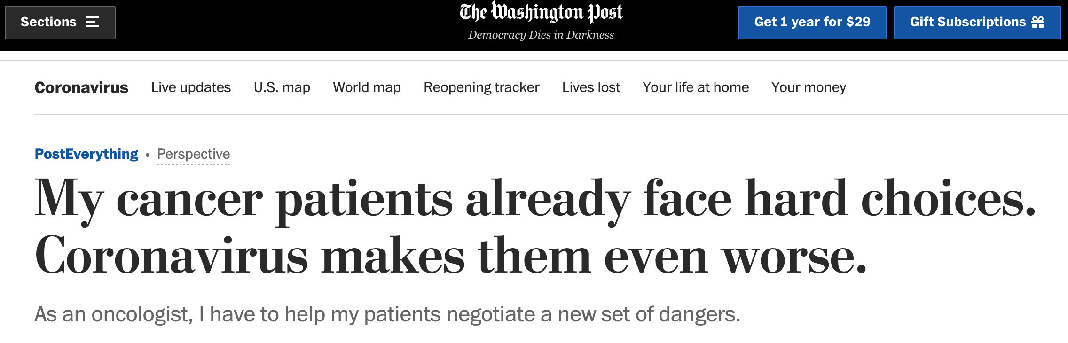
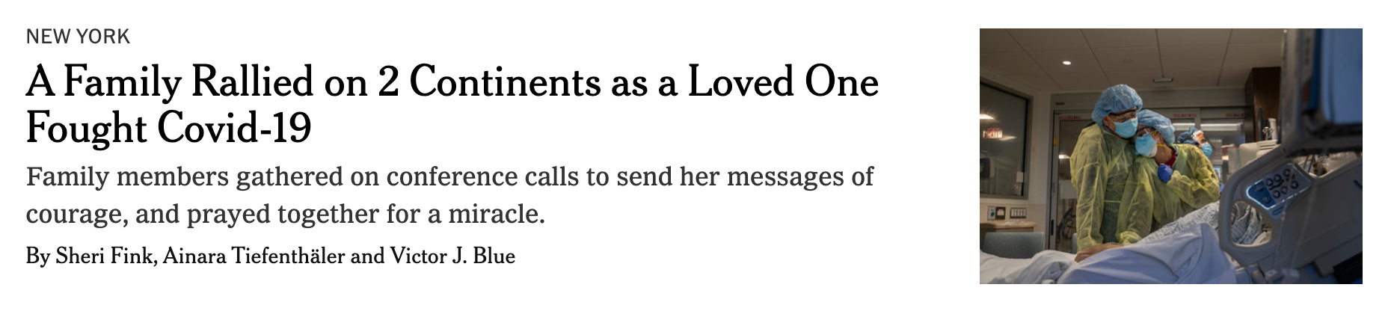
Palliative Care: Essential Services During COVID-19
Notes:
Anyone at risk (including ppl with serious illness, older adults)
Ppl with serious illness who need care despite a global pandemic
People with COVID who are suffering and alone
…and the need is huge. All health professionals need to address palliative care needs

Slide 41
Patient Voices
“Thanks for never letting me feel isolated and in the dark through this very dark time in our lives."
“Thank you for doing the work to find out what I wanted."
"It made us feel loved. I know that my hospital and its staff really cares for us!"
Notes:
Grandmother passed away, mom and dad remain on vent day 24+ and status tenuous
COVID-positive patient in the ICU and delirious – family disagreement about what he would want – palcare team held a family mtg to discuss and re-frame toward what’s important to him – did not intubate, patient emerged from delirium and expressed gratitude – wanted to be at home
Relative stuck at home while family member receiving care for COVID in the hospital

Slide 42
Palliative care steps up
Image Source: Clip Art Library

Slide 43
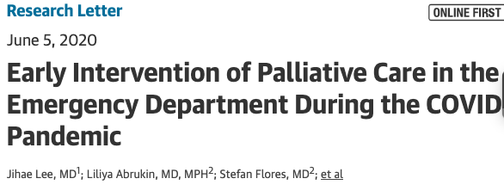

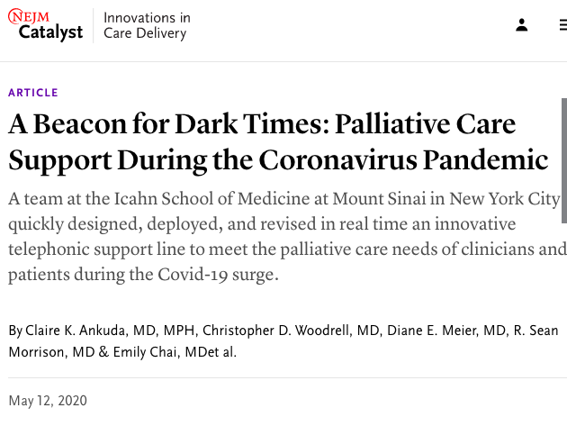
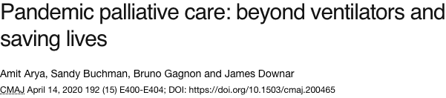
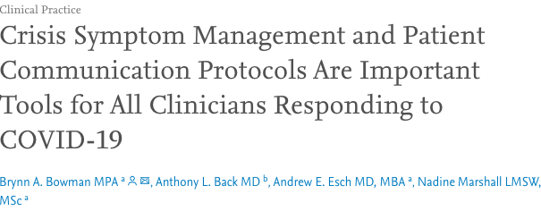
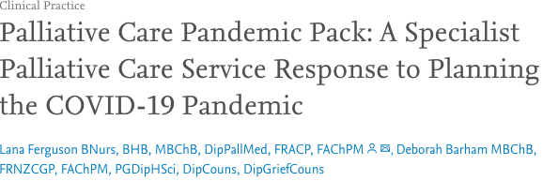
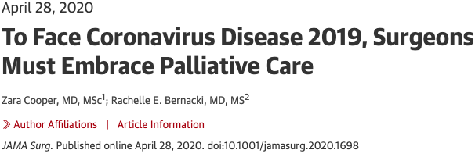
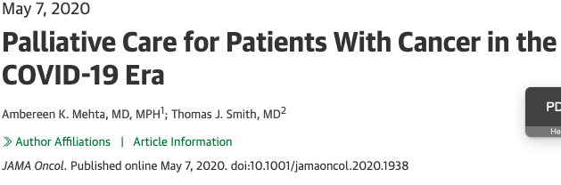
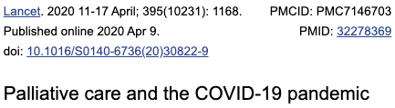

Slide 44
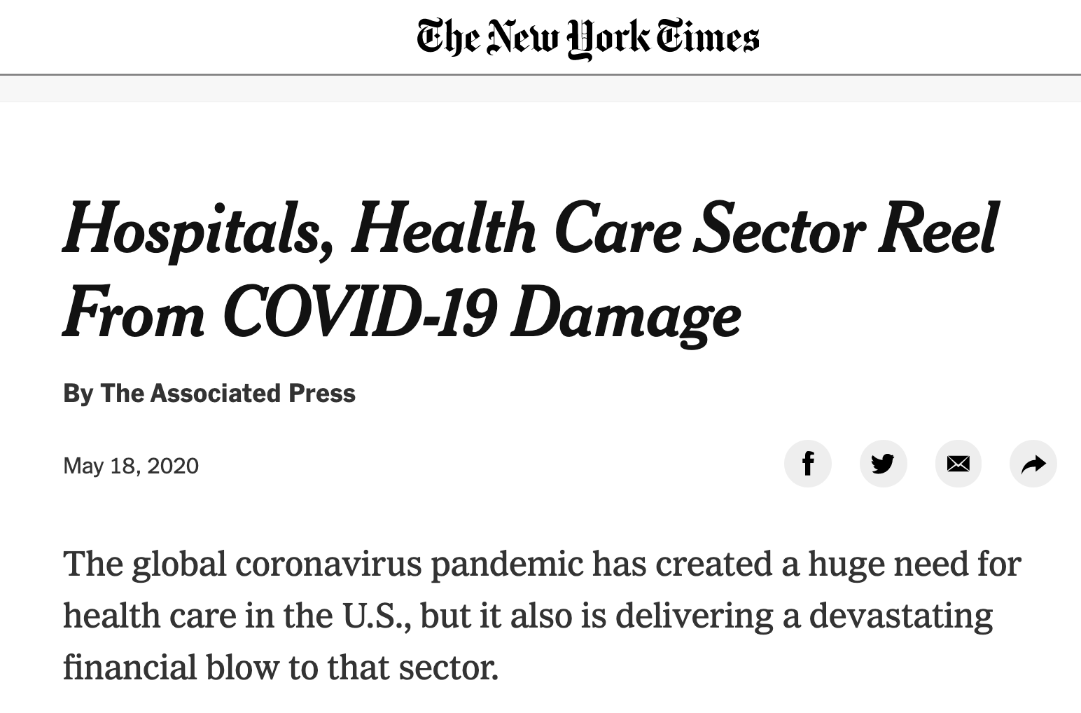


The Future of Palliative Care: In the COVID Era and Beyond
VS.
Notes:
What is the future of palcare now?
All over health care, efficiency and revenue-generation will be king
Palcare’s challenge - we are not a high-revenue proposition. But we do:
-Improve quality in ways that are critically important for patients, and translate to $$ for orgs (readmits, cost-per-stay, LOS, prevention of HACs, etc)
-Provide critical support to colleagues from other specialties to reduce burnout [recall the NYT article about how we’re all delivering palcare] – the principles and practices of palcare have never been more salient (here’s example - NYT)
-Work flexibly to design solutions for the most vulnerable patients - this is what we did before COVID, & we’re better prepared than any other specialty to handle the profound uncertainty & vulnerability in this moment

Slide 45
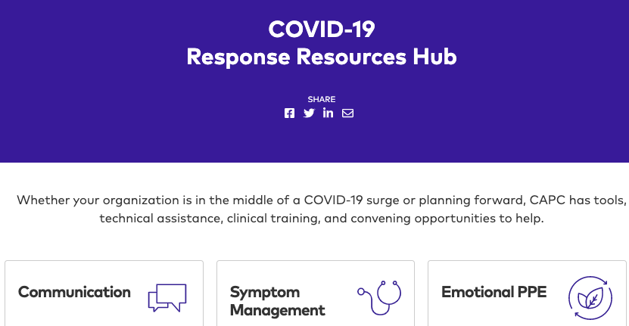
FREE to ALL
https://www.capc.org/covid-19/

Slide 46
Recipe for Success
1. Inpatient Specialty Consult Service
Improved satisfaction
2. Community Access to Specialists
Reduced symptom burden
Reduced total costs
3. Training for ALL CLINICIANS
Goal-concordant care
Decreased length of stay
Cost avoidance
Reduced utilization
Decreased readmissions
Improved efficiency
Improved ROI on existing palliative care capacity
Hospice capacity
Notes:
National/general view – how do these 3 components = highest-value care for patients with serious illness
Catholic Health historically been way out ahead on this issue

Slide 47

"Every day I remind myself that my inner and outer life are based on the labors of other men [and women], living and dead, and that I must exert myself in order to give in the same measure as I have received and am
still receiving.”
Albert Einstein, 1935
The World As I See It

Slide 48
THANK YOU!!

Slide 49
Resources

Slide 50


Slide 51
CAPC Clinical Training
CLINICAL | Pain Management
 | Comprehensive Pain Assessment | Matching the Drug Class to the Pain | Patient Factors that Influence Prescribing Decisions | Assessing Risk for Opioid Substance Use Disorder | Opioid Trials: Determining Design, Efficacy, and Safety
 | Prescribing an Opioid | Prescribing Short-Acting Opioids – Four Case Studies | Monitoring for Opioid Efficacy, Side Effects and Substance Use Disorder | Converting from Short-Acting to Long-Acting Opioids | Prescribing Practice and Opioid Conversions
 | Advanced Conversations and Opioid Side Effects | Special Populations and Patient-Controlled Analgesia | Managing Pain in Patients at Risk for Substance Use Disorder | Pain Management: Putting it All Together
 | Communication Skills
 | Delivering Serious News | Discussing Prognosis | Clarifying Goals of Care | Conducting a Family Meeting | Advance Care Planning Conversations
 | Symptom Management
 | Nausea and Vomiting | Dyspnea | Constipation | Depression | Anxiety
 | Relief of Suffering Across the Disease Trajectory (Coming Soon)
 | Congestive Heart Failure (CHF) | Dementia | Chronic Obstructive Pulmonary Disease (COPD)
 | Prevention Crises Through Whole-Person Care (Coming Soon)
 | Care Coordination for the Seriously Ill Patient | Supporting the Family Caregiver: The Burden of Serious Illness

Slide 52
CAPC Operational Training
Operational | Building Your Hospital Program
 | Needs Assessment for the Hospital Palliative Care Program | Hospital Palliative Care Program Design | Building the Business Plan for Your Hospital Palliative Care Program
 | Building Your Community Program
 | Introduction to Palliative Care in the Community | Needs Assessment: Ensuring Successful Community-Based Palliative Care | Office-Based Palliative Care Program Design
 | Building the Business Plan for Community-Based Palliative Care | Program Design for Palliative Care Delivered in the Home | Designing Your Long Term Care Palliative Care Program
 | Leadership Support
 | An In-Depth Look at Palliative Care and Its Services | Improving Team Performance | Consult Etiquette: Communicating with Referring Providers

